Slide 1
Selected Topic:
Data Analyst Jobs Analysis a Tool for our Us & our Collegues
Developed by:
The Psycho_Data_Squad! @ DU
Jacquie, Justin, Taylor, & Julie
November, 2021

Slide 2

Where will your future take you?

Slide 3

The process:
Machine Learning, draft then final- Design/Prototyping/Finalizing/continuous improvement process, draft, then final
- Takes in the provisional DB & - Outputs labels for input data
Description of the prelim feature engineering, selection, and decision-making process
Machine Learning, description of how dtaa was split into t & t
Machine Learning explanation of model choice, including pros and cons
Database Development with sample Data testing/developing the db structure/schema(s) practice with prototypes
Database Development-including a least 2 tables joined (in Mongo)
Include at lease 1 connection string (sqlalchemy or pymongo)
Repository Practice/Teaming- multiple commits for each
Presentation Development
With descriptions of data exploration phase of the project and the analysis phase of the project
#2
Presentation Upload all code so far to Git Hub shared repo
Machine Learning, draft then final- Design/Prototyping/Finalizing/continuous improvement process, draft, then final
- Takes in the provisional DB & - Outputs labels for input data
Description of the prelim feature engineering, selection, and decision-making process
Machine Learning, description of any recent changes/improvements
Database enhancements and descriptions
Build an APP using Flask and Mongo DB
Finalize Presentation
Finalize DB
Finalize ML
Finalize APP work
Self-Assessments
Team-Assessments
#3
#4
Topic Selection, Reason
Data Selection & Description
Shared GitHub Repository Set-up, with individually managed branches
#1

Slide 4
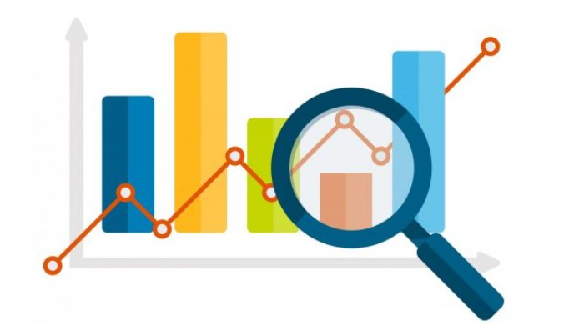

Initial Data Analysis
Basic Measures/info
Analysis

Slide 5
The Data Sets
Project Overview:
For this project we are analyzing datasets from Kaggle Dataset Repository.
Description of the Source Data:
One dataset contains job openings advertisements for Data Analyst Jobs - from 1 year ago - approx 2253 records total. The second dataset needed will be Longitudes and Latitudes - a way to map some results on a map, interactively.
An additional dataset, called _________________needed is joined to collect ____________info
Jacquie, can I add yours here or leave it later?
Analysis

Slide 6
Analysis
Questions we hope to answer.
In this analysis I will be focusing on the following questions:
- � What is the Minimum Salary?
- � What is the Maximum Salary?
- � What is the Average Salary?
- � What are the number of Job Openings by Job Title?
- � What are the number of Job Openings by Industry?
- � What are the number of Job Openings by Sector?
- � Correlation between Variables?
- � What attributes are most important in predicting the salary of a job?
- � Is a certain type of _______________associated with ______________?
- � Do companies with higher ratings pay higher salaries?
- � Do companies with lower ratings pay lower salaries?
- �
- �
- �

Slide 7
Attribute Information:
- Job Title
- Rating
- Company Name
- Industry
- Sector
- Salary Minimum - added this column
- Salary Maximum - added this column
- Salary Average - added this column
- ADDED Salary Low Bottom of Range
- ADDED Salary Med Middle of Range
- ADDED Salary High Top of Range
- ADDED Salary Level
Considerations we could extract:
- Python Jobs
- SQL Jobs
- Excel Jobs
- Tableau jobs
Analysis

Slide 8
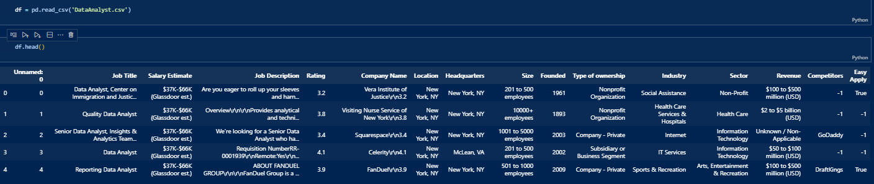
The Data Analysis Story
Analysis/ETL
We begin with 1 of the original datasets - We have a lot of information!
What specific data do we really need to begin analysis?
Salary metrics and A categorical “easy-apply” value y/n
We begin the work to Extract, Transform, and Load (ETL)
Click here for the Code

Slide 9
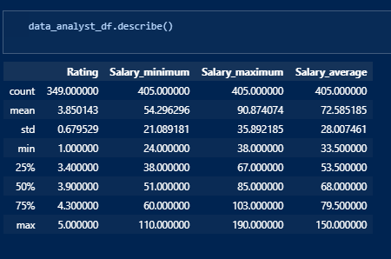
Develop New DataFrames with Pandas
Analysis/ETL
Developed a Min, Max, and Avg to work with in
future charts and visualizations

Slide 10
Develop Visuals with Plotly
Analysis/ETL
Developed a Min, Max, and Avg to work with in future charts and visualizations

Slide 11
Analysis/Visualization
Let's look at the some of the information we can get from above table:
Average and also median value for the ratings of the companies very close to 4 (at round 3.7)
Average minimum salary is around 54K and median value for minimum salary is around 50K. We can expect outliers from salary distribution and we acn also expect right skewed distribution of the minimum salary.
Average maximum salary is almost 90K (89.97) and median value for maximum salary is 87K. We can expect outliers from salary distribution and we can also expect right skewed distribution of the maximum salary.
Average salary is around 72K, but still we can expect several outliers for this variable(min= 33.5K, max= 150K)
With Python and Matplotlib we can plot a histograms in one line of code, and observe the frequency of distribution for various features. We can read frequency on y-axis and feature values on the x-axis. We can easily plot histograms for the entire dataset, for all features as well as individual features to get a more detailed look.

Slide 12
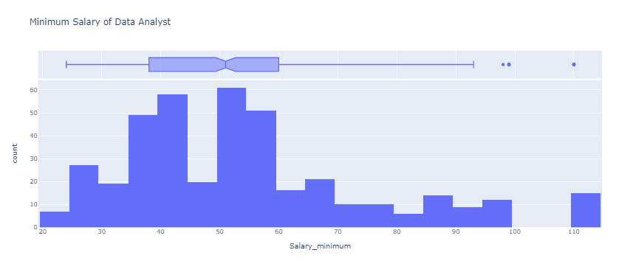
� What is the Minimum Salary?
Analysis/Visualization

Slide 13
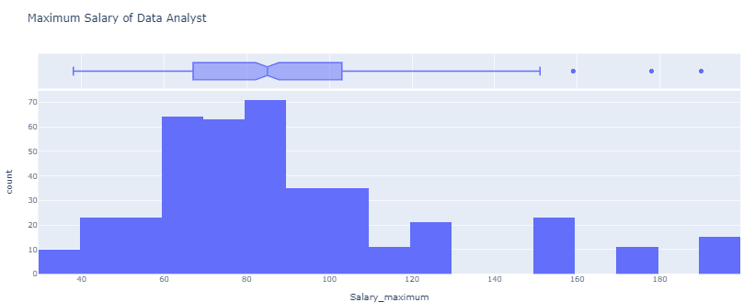
� What is the Maximum Salary?
Analysis/Visualization

Slide 14
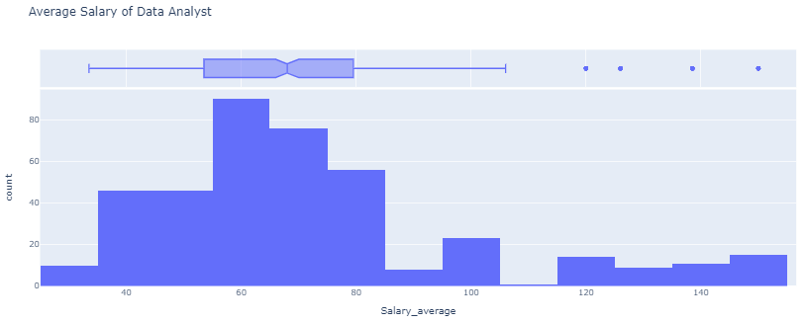
� What is the Average Salary?
Analysis/Visualization

Slide 15
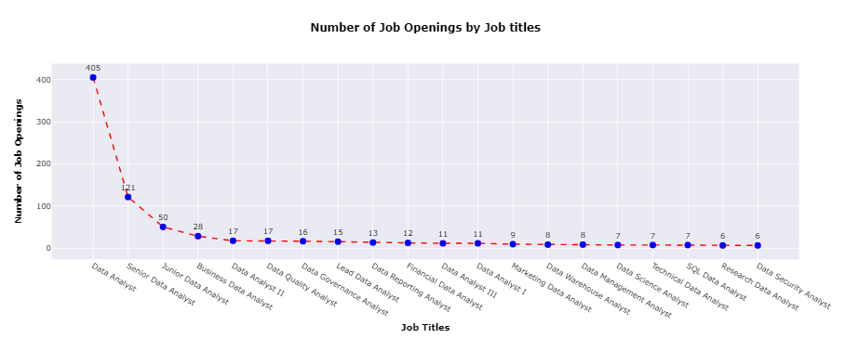
� What are the number of Job Openings by Job Title?
Analysis/Visualization

Slide 16
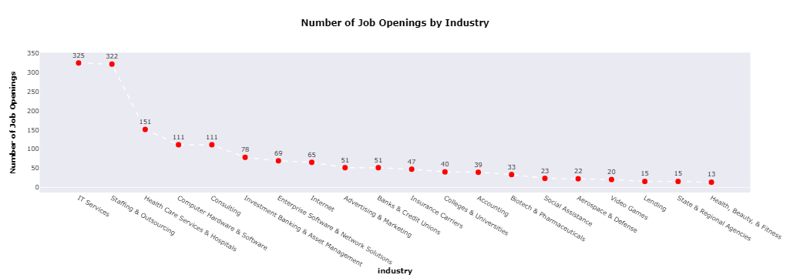
� What are the number of Job Openings by Job Title by Industry?
Analysis/Visualization

Slide 17
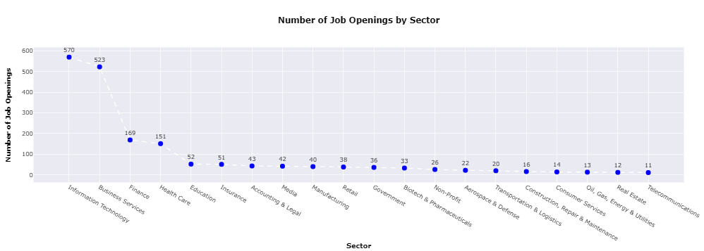
� What are the number of Job Openings by Job Title by Sector?
Analysis/Visualization

Slide 18
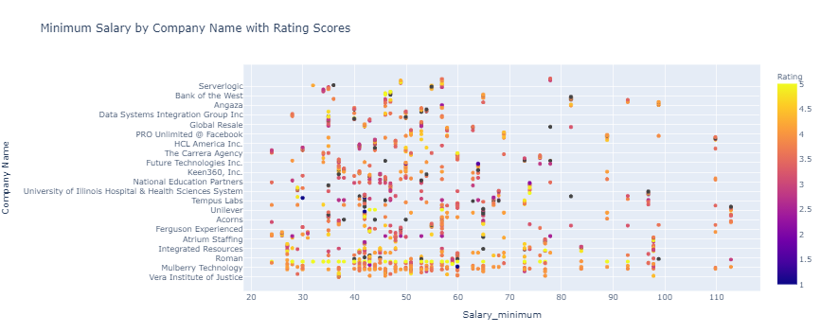
� Minimum Salary by Company Name with Rating Scores?
Analysis/Visualization
Distributions and Correlations - looking for patterns & relationships

Slide 19
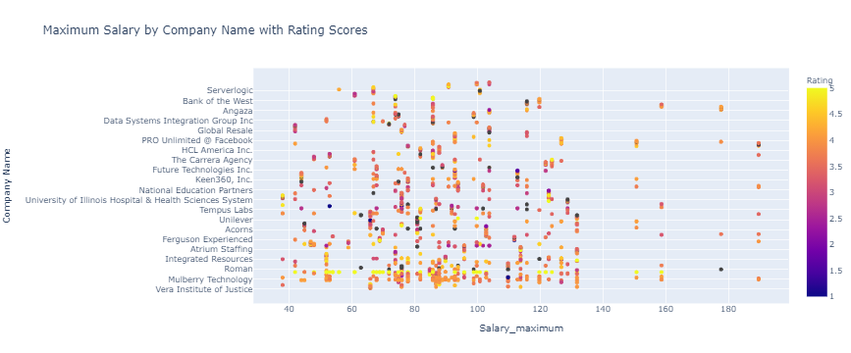
� Minimum Salary by Company Name with Rating Scores?
Analysis/Visualization
Distributions and Correlations - looking for patterns & relationships

Slide 20
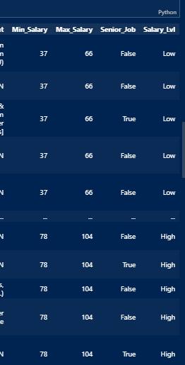
Deep Dive on the Data Cleaning & Transformation
Developed multiple data frames to continue to
extract needed key information into the correct format
Deeper Dive into the Data
Added a Senior Job column - T/F
Added a Salary Level column - Low, Med, High based on the Salary Ranges
Click here for the Code

Slide 21
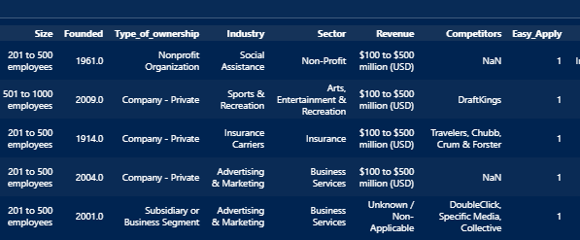
Deep Dive on the Data Cleaning & Transformation
Developed multiple data frames to continue to
extract needed key information into the correct format
Deeper Dive into the Data
Recoded 3 columns
Size,
Revenue,
& Easy Apply

Slide 22

Deeper Dive into the Data
Deep Dive into Graphics:
Preparing the File Structure & Components for an App?
Merged/Joined columns to combine lat/long to have a csv for the map we will create using leaflet.Push to Github - Part 1
Built the index.html, CSS file and its contains, logic.js file and its contents.
Connected with Mapbox Styles API
Add the config.js File
Add examples here
Click here for the Code

Slide 23
Joined Tables-part 2
Deeper Dive into the Data
DB in PG Admin - 2 joined tables -
cities_df_new and 2) data analyst
on city column -
Add examples here

Slide 24
Data Base work

Slide 25
Data Base work

Slide 26
HTML APP etc.

Slide 27
HTML APP etc.

Slide 28
HTML APP etc.

Slide 29

How to deploy ML using Flask
Machine Learning
TEXT USER INPUT
Web Page
2. Send query to Flask
4. Send the predicted label to the webpage
Flask Server
ML Prep starts by ASKING:
What are we predicting?
What will be our predictor?
What are our features?
3. Send request to predict based on TEXT INPUT
4. Get Predictions
Random Tree Model
ML pipeline

Slide 30
“Cleaning 3”- snipit put here
Machine Learning
We want to build a model that will predict the probability of getting a high paying job (3), medium paying job (2), and a lower paying job (1) in Denver, for example.
This information can be used by a Data Analyst looking for a Data Jobs because it will guide the Job searcher in their activities.
How well do these positions pay by Company Name, & Company Rating, Location (State), Job title, Industry, Type of Ownership, Salary Estimate (top of range? or something else),
Put it on a map

Slide 31
Machine Learning File structure
See Taylors code and graphs here
ML MODEL DEPLOYMENT USING FLASK
1.build the model
2.deploy using flask
Files to be created
1.model.py(ML model)
2.model.pkl (pickle file from ML model)
3.app.py
4.index.html
5.data.csv
Click here for the Code
Machine Learning
Tip
In this example, we’re leading off with something unexpected.
While the audience is trying to come up with a number, we’ll surprise them with the next slide.

Slide 32
Machine Learning File structure
Description of preliminary data preprocessing
Description of preliminary feature engineering and preliminary feature selection, including the decision-making process
Description of how data was split into training and testing sets
Explanation of model choice, including limitations and benefits
Machine Learning
Tip
In this example, we’re leading off with something unexpected.
While the audience is trying to come up with a number, we’ll surprise them with the next slide.
Or here Click here for the Code

Slide 33
Machine Learning

Slide 34
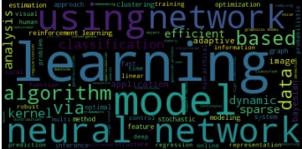
“Word Cloud - most frequent topics at the most recent ML Conference

Slide 35
4. Closing
Build confidence around your product or idea by including at least one of the these slides:
Milestones What has been accomplished and what might be left to tackle?
Testimonials Who supports your idea (or doesn’t)?
What’s next? How can the audience get involved or find out more?

Slide 37
XTRA stuff if needed below here

Slide 38
Analysis/Visualization
Might find a home for this ??
EDA (Data Investigation Data Cleaning & Feature Engineering)
EDA (Exploratory Data Analysis) as in “A first look at the data” is used to understand and summarize the content of the dataset, such as initial look at the columns, data
types, data quality, data statistics and data relationships. Moreover, data often require a significant amount of work to make it suitable for analysis like cleaning, feature
engineering and visualizing. Python packages such as Pandas, NumPy and Matplotlib help work faster and more efficiently when performing EDA.
Data Processing
In order to perform sufficient data analysis data needs to be manipulated. In this analysis we used Pandas functions such as groupby, query and binning amongst others. Data
processing and data manipulation is essential for any data analysis and with a thoughtful approach we can get useful insights about the given dataset and recommendations beyond
this analysis.
Research Questions
As mentioned above EDA is an important step in data analytics. This critical step can save roughly 15–50% of time on a project because it provides a targeted plan for how to
clean, sort, and create smaller datasets that are easier to work with. It is also extremely important to familiarize with the dataset, what various features mean and what
values represent. Based on that we can conclude what questions can be answered from the data or do we need to collect more data in order to provide comprehensive analysis.
ADD A HEAT MAP ? maybe? Find more correlations to look into.
Data Analyst Jobs in America by Geographic Location Analyzing a mix of factors to uncover any correlations.
Using a variety of tools, we will look at how jobs statistics look by state in the future. Our presentation can be found here [link to Google Slides] In the future we will develop the Dashboard(s)
Interactive Webpage Dashboard (like BB)
- Graphic across top,
- 1 selection panel - pull down menu with all American States -select by state
- 1 chart - BAR - Top 10 jobs for that state by Salary (top range)
- 1 chart - BUBBLE - show the distribution of Jobs by Industry or Sector
- 1 chart - GAUGE or something different
- Dashboard 1 -- Tableau Our Tableau analysis can be found here [Tableau Dashboard].
- Dashboard 2 -- an interactive webpage using machine learning to calculate....
Link to the dashboard repository []
Pull down menu by state
* possibly Link to deployed dashboard is herokuapp.com *
May need this info

Slide 42
2. Examples
By the end of this section, your audience should be able to visualize:
What What is the pain you cure with your solution?
Who Show them a specific person who would benefit from your solution.

Slide 43

Meet Alberto.
He recently moved from Spain to a small town in Northern Ireland.
He loved soccer, but feared he had no way to talk to a coach or teammates.
Tip
Tell the audience about the problem through a story, ideally a person.

Slide 44

Meet Marcos.
He recently opened a camera shop near the Louvre in Paris.
Visitors to his store, mostly tourists, speak many different languages making anything beyond a simple transaction a challenge.
Tip
If one example isn’t sufficient to help people understand the breadth of your idea, pick a couple of examples.
Story for illustration purposes only

Slide 45

A translation barrier left Alberto feeling lonely and hurt Marco’s business.
Tip
Ideally, speak of people in very different situations, but where each could benefit from your solution.

Slide 46

Then, Marcos discovered Google Translate
He has his visiting customers speak their camera issues into the app.
He’s able to give them a friendly, personalized experience by understanding exactly what they need.

Slide 47

A simple gesture
Coaches Gary and Glen knew no Spanish.
They used Google Translate to invite Alberto to join in... “Do you want to play?”... “Can you defend the left side?”
Tip
Show how your solution helps the person in the story reach his or her goals.

Slide 48

From outsider to star
Alberto scored 30 goals in 21 games. He is now being scouted by several professional clubs in the Premier League. And he’s a favorite of the other boys on the team.
See a short video on Alberto’s story
Tip
Stories become more credible when they use concrete details such as the specific complex moves Alberto learned through Translate and his 30 goals in 21 games performance stats.

Slide 49
3. Examples
People need to understand how rare or frequent your examples are.
Pick 1 or 2 statistics and make them as concrete as possible. Stats are generally not sticky, but here are a few tactics:
Relate Deliver data within the context of a story you’ve already told
Compare Make big numbers digestible by putting them in the context of something familiar

Slide 50
It’s no surprise Marcos uses Google Translate in his shop regularly.
There are 23 officially recognized languages in the EU.
Tip
Don’t let data stand alone. Always relate it back to a story you’ve already told, in this case, Marco’s shop.
Source: theguardian.com

Slide 51


More than 50 million Americans travelled abroad in 2015
THAT’S MORE THAN THE POPULATION OF
CALIFORNIA AND TEXAS COMBINED
Tip
When a number is too large or too small to easily comprehend, clarify it with a comparison to something familiar.
Source: travel.trade.gov

Slide 52
Milestones
October 2014
October 2015
August 2015
November 2015
Translate web pages with Chrome extension
Translate text within an app
2014 |  |  |  | 2015
Translate conversations through your Android watch
Translate written text from English or German to Arabic with the click of a camera

Slide 53
What people are saying
With this app, I’m confident to plan a trip to rural Vietnam
Wendy Writer, CA
Visual translation feels like magic
Ronny Reader, NYC
Translate has officially inspired me to learn French
Abby Author, NYC
Quotes for illustration purposes only

Slide 54

Know a 2nd language? Make Google Translate even better by joining the community.
Tip
Inspire your audience to act on the information they just learned.
Depending on your idea, this can be anything from downloading an app to joining an organization.

Slide 55

Good luck!
We hope you’ll use these tips to go out and deliver a memorable pitch for your product or service!
For more (free) presentation tips relevant to other types of messages, go to heathbrothers.com/presentations
For more about making your ideas stick with others, check out our book!

Slide 56
Just one! Your own.
(With a little help from your smart phone)
Tip
Remember. If something sounds like common sense, people will ignore it.
Highlight what is unexpected about your topic.

Slide 57
Selling your idea
Created in partnership with Chip and Dan Heath, authors of the bestselling book Made To Stick, this template advises users on how to build and deliver a memorable presentation of a new product, service, or idea.

Slide 58
HTML APP etc.
HTML APP etc.
HTML APP etc.

